Slide 1

SURVIVAL ANALYSIS Kaplan-Meier Estimate and Patients at Risk Emily Foreman
Notes:
So today I’m going to be giving a presentation on Survival Analysis, focussing on the Kaplan-Meier Estimate and Patients at Risk. This presentation is part of the series of talks to be given in the stats forum as an introduction to statistical processes that we may come across in our day-to-day work at Phastar. Last month, Katie and Albert kicked these talks on with a great introduction to logistic regression and today, I will be talking about some of the basics of survival analysis. I will just be covering the very basics so should hopefully be relatively straightforward, however, Jen Rogers and I will also be running a more in depth survival analysis training that will be rolled out, hopefully very soon!

Slide 2
Overview
Survival data
Kaplan-Meier Estimate
The Theory
Example
SAS Code and Options
Resources
Notes:
So, as I’ve already mentioned, I’ll start by discussing just a little bit of the theory about survival data and Kaplan Meier, as well as looking at a very simple example. I’ll then just go over how we would go about implementing this in SAS, using the same example as in Section 2. And I’ll finish with a few useful resources that you can look at for further information on what I cover today.

Slide 3
1. SURVIVAL DATA
Notes:
So lets get started…

Slide 4
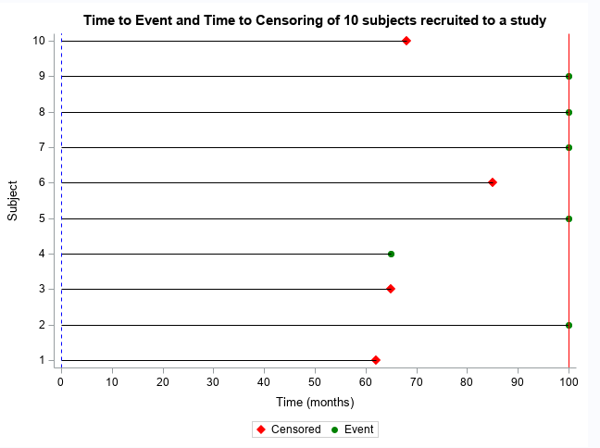
What is survival data?
Survival data occur where times are recorded from a specific, well defined time origin until the occurrence of some pre-defined event or end-point of interest for a group of individuals.
Examples:
Time from randomization to death (Overall Survival)
Time until progression or death (Progression Free Survival)
Time to onset of first Adverse Event
Recruited to Study
Analysis Point
Notes:
What is survival data? Survival data occur where times are recorded from a specific, well defined time origin until the occurrence of some pre-defined event or end-point of interest for a group of individuals. The time origin is something that needs to be defined in advance, however most commonly in clinical trials, we are interested in randomization as our time origin, meaning we are interested in the time from randomization to some pre-defined event. Similarly, our event or end-point is something that needs to be well-defined. Commonly this is death, which is why we call this ‘survival’ data, so we would be interested in the time from randomization to death, also known as the overall survival of a patient. However this event can be any number of things, and I’ve just given a couple more examples on the slide.

Slide 5
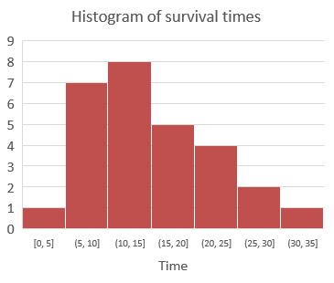
What is survival data?
Features of survival data:
All times are ≥0 therefore data are unlikely to come from a Normal distribution
Generally, survival data are positively skewed
Some subjects whose time-to-event is unknown. In this case we only know that the event of interest did not occur before a certain time. This time is defined as the censored time of the subject.
Examples:
Subjects still alive at end of study
Subjects discontinued before end of study without experiencing event of interest
Censoring should be non-informative
Notes:
Some of the key things that we need to remember about survival data are firstly that times are always greater than zero and therefore the data are unlikely to come from a normal distribution. Furthermore, survival data are often positively skewed, so we will see quite a lot of the events at the start of our observation period, and then as time goes on, these events will be seen fewer and fewer as we have less subjects left to observe. This means that we don’t have the traditional bell-shaped curve that we would expect from a normal distribution.
Secondly, we will have some subjects who do not observe the event of interest in our given time frame, and only know that their event of interest did not occur before a certain time. These subjects are censored at this time, and we need to consider how best to deal with these subjects during analysis. For example, if the event of interest is death and we have subjects still alive at the end of the study, we would censor these at the study end date. Or perhaps a subject is lost to follow-up without experiencing the event of interest. For example, we might know that a subject is still alive at the first scheduled visit, but the patient withdraws from the study before the next scheduled visit, and we are therefore unable to assess when or whether the subject died during the study period. The important assumption for us is that any censoring is non-informative, which means that a subject who is censored should be representative of all other subjects who have yet to experience the event of interest. So in our example, if our subject that was lost to follow-up withdrew because they moved away, then this is unrelated to their unknown survival time and we can consider their censoring to be non-informative, whereas if they withdrew because their health deteriorated then we might expect their survival time to be lower than those of the subjects remaining in the study, in which case their censoring would be informative. Censoring is an important topic within survival analysis and one that we could probably do an entire stats forum on, so in the interest of saving time, I’m going to leave it at that fairly simple introduction, however we will talk more about censoring, including the concept of non-informative censoring as well as the different types of censoring in more detail in the formal survival analysis training, if you do want to know more.

Slide 6
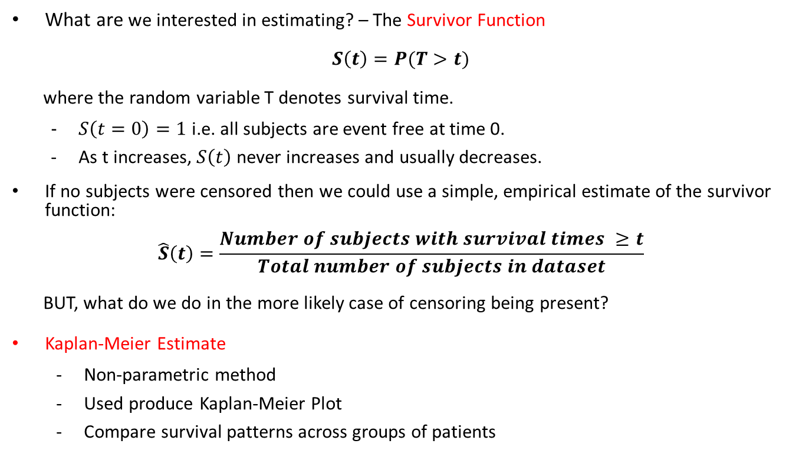
What is survival data?
What are we interested in estimating? – The Survivor Function
$$S\left(t\right)=P(T>t)$$
where the random variable T denotes survival time.
$S\left(t=0\right)=1$ i.e. all subjects are event free at time 0.
As t increases, $S\left(t\right)$ never increases and usually decreases.
If no subjects were censored then we could use a simple, empirical estimate of the survivor function:
$$\hat{S}\left(t\right)=\frac{Number of subjects with survival times ≥t}{Total number of subjects in dataset}$$
BUT, what do we do in the more likely case of censoring being present?
Kaplan-Meier Estimate
Non-parametric method
Used produce Kaplan-Meier Plot
Compare survival patterns across groups of patients
Notes:
So, taking all of this into consideration, we now want to consider how we can go about estimating our survivor function, S(t), which is the probability that an individual survives beyond a certain time t, event free. There are two important properties that need to be adhered to when calculating the estimates of the survivor function. First that S(t) should be equal to 1 at time 0, since all subjects should be event free at the start of our observation period. And second that, over time, S(t) should never increase, and will usually decrease, which basically means that the probability of a subject ‘surviving’ decreases as time progresses.
In the rare case that none of our subjects were censored, so they all observed the event of interest, then we can simply calculate an empirical estimate of the survivor function, as given on the slide. But, we all know from experience that this is very unlikely to happen in reality, so what do we do then? This is where our Kaplan Meier estimate comes into play…
In addition to being a useful tool to deal with censored data, using Kaplan-Meier to estimate the survival function has a number of other benefits. Firstly, it is a non-parametric method and therefore can estimate the survival function without having to make parametric assumptions about the data. Secondly, we can use the Kaplan-Meier estimates to produce a Kaplan-Meier plot, which is a nice way of graphically displaying survival data. And finally, it provides a simple way of comparing survival patterns in 2 or more groups of patients, for example between treatment groups, which can further be used to inform more complex modelling of the data.

Slide 7
2. KAPLAN-MEIER ESTIMATE
Notes:
So I’ll just quickly go through the steps use to calculate the Kaplan Meier estimates of the survivor function, which are what SAS will do for you whenever you run your code…

Slide 8
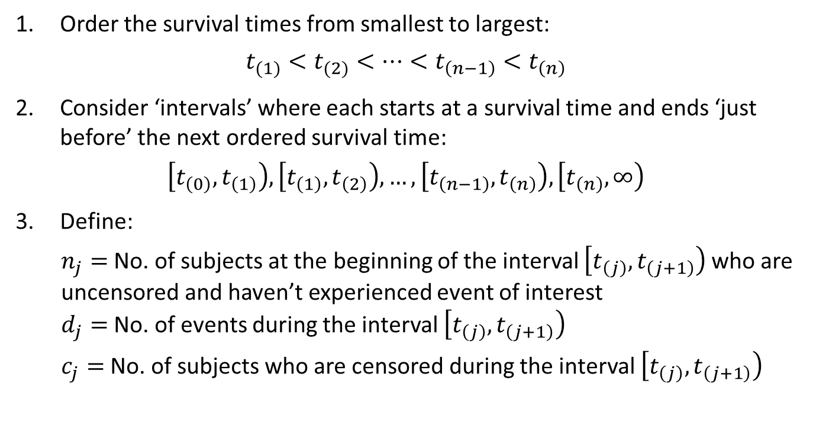
Kaplan-Meier Estimate
Order the survival times from smallest to largest:
$$t_{(1)}<t_{(2)}<…<t_{\left(n−1\right)}<t_{\left(n\right)}$$
Consider ‘intervals’ where each starts at a survival time and ends ‘just before’ the next ordered survival time:
$$\left[t_{\left(0\right)},t_{\left(1\right)}\right), \left[t_{\left(1\right)},t_{\left(2\right)}\right),…,\left[t_{\left(n−1\right)},t_{\left(n\right)}\right), \left[t_{\left(n\right)},∞\right)$$
Define:
$n_{j}=$ No. of subjects at the beginning of the interval $\left[t_{\left(j\right)},t_{\left(j+1\right)}\right)$ who are uncensored and haven’t experienced event of interest
$d_{j}=$ No. of events during the interval $\left[t_{\left(j\right)},t_{\left(j+1\right)}\right)$
$c_{j}=$ No. of subjects who are censored during the interval $\left[t_{\left(j\right)},t_{\left(j+1\right)}\right)$
TIME ORIGIN
PATIENTS AT RISK
Notes:
Firstly, we want to order the survival times from smallest to largest. We include our censoring times in this ordered list, but it is important to remember that the times t(1) etc. represent the observed event times only.
Secondly, we consider intervals. Each interval starts at a survival time, except the first interval, which starts at the time origin. And each interval ends ‘just before’ the next survival time, except the last interval which starts at the last observed survival time, and extends infinitely, in order to capture any censored times that may have occurred after the last observed event in the data.
Next, we have a few definitions. Nj is the number of subjects at the beginning of each interval who are uncensored and have not experienced the event of interest, which is equivalent to the number of patients at risk at the beginning of that interval. Dj is the number of events during the same interval. And Cj is the number of subjects censored in the interval.

Slide 9

Kaplan-Meier Estimate
Probability of ‘surviving’ the interval $\left[t_{\left(j\right)},t_{\left(j+1\right)}\right)$ is given by
$${\hat{p}}_{(j)}=\frac{n_{j}−d_{j}}{n_{j}}.$$
The Kaplan-Meier estimate of the survivor function for $t∈\left[t_{\left(k\right)},t_{\left(k+1\right)}\right)$ is
$$\hat{S}\left(t_{(k)}\right)=\prod_{j=0}^{k}{{\hat{p}}_{j}}.$$
Notes:
We can then use Nj and Dj, as defined on the previous slide to calculate the probability of ‘surviving’ this interval. This is denoted Pj, and is calculated as per step 4 here, which in simpler terms, is the number of subjects who ‘survived’ the interval, over the number of subjects who were present at the start of the interval. Finally, the survivor function at each time point can then be estimated as the product of each Pj up to time t.

Slide 10
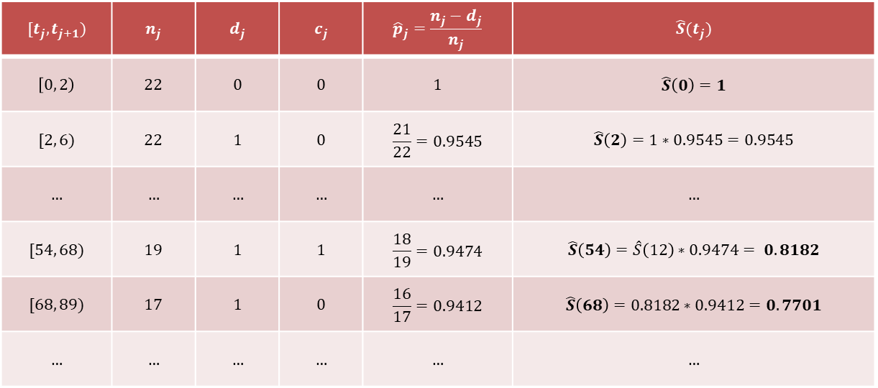
Example
Survival times, with * denoting censored time (Kirk et al. (1980)):
Placebo: 2, 3, 4, 7, 10, 22, 28, 29, 32, 37, 40, 41, 54, 61, 63, 71, 127*, 140*, 146*, 158*, 167*, 182*.
Prednisolone: 2, 6, 12, 54, 56*, 68, 89, 96, 96, 125*, 128*, 131*, 140*, 141*, 143, 145*, 146, 148*, 162*, 168, 173*, 181*.
Computation of KM estimate for Prednisolone group…
$$[t_{j},t_{j+1})$$ | $$n_{j}$$ | $$d_{j}$$ | $$c_{j}$$ | $${\hat{p}}_{j}=\frac{n_{j}−d_{j}}{n_{j}}$$ | $$\hat{S}(t_{j})$$
$$\left[0, 2\right)$$ | $$22$$ | $$0$$ | $$0$$ | $$1$$ | $$\hat{S}\left(0\right)=1$$
$$[2, 6)$$ | $$22$$ | $$1$$ | $$0$$ | $$\frac{21}{22}=0.9545$$ | $$\hat{S}\left(2\right)=1∗0.9545=0.9545$$
$$…$$ | $$…$$ | $$…$$ | $$…$$ | $$…$$ | $$…$$
$$[54, 68)$$ | $$19$$ | $$1$$ | $$1$$ | $$\frac{18}{19}=0.9474$$ | $$\hat{S}\left(54\right)=\hat{S}\left(12\right)∗0.9474= 0.8182$$
$$[68, 89)$$ | $$17$$ | $$1$$ | $$0$$ | $$\frac{16}{17}=0.9412$$ | $$\hat{S}\left(68\right)=0.8182∗0.9412=0.7701$$
$$…$$ | $$…$$ | $$…$$ | $$…$$ | $$…$$ | $$…$$
PATIENTS AT RISK
Notes:
So this is just a very simple example taken from the reported findings of a randomized trial of prednisolone in 44 patients with chronic active hepatitis. The outcome of interest is survival time, so we have the time to death in months of 22 subjects on Placebo, and 22 subjects on Prednisolone and we can see there were censored subjects in both treatment groups, indicated here by an asterisk.
Here we consider the calculation of the estimates of the survival function for the Prednisolone group. First, we would order the survival times, which we can see is already done here and secondly, we set up the intervals which are given in the first column of the table. The following three columns contain the numbers of subjects as defined in step 3, so Nj is the number of uncensored subjects at the start of the interval who have not yet died, Dj is the number of subjects who die during this interval, and Cj, the number of subjects who were censored during the interval. The fourth column contains our calculation for Pj, so the number of subjects who survive the interval, over the number of subjects alive at the start of the interval. And finally, in the last column we have our survival estimates, S(t), which by definition is 1 at time 0, and continues to be the product of Pj at each time point up to time t.
So as previously mentioned, the second column, Nj, is equivalent to the number of patients at risk at each time point. This takes into consideration, not just the number of events at the previous time point, but also any subjects who were censored. So for example, in the third row we see that there were 19 subjects at risk at the start of the interval, and one of these subjects died. However we also have one subject who was censored, which means that the number of patients at risk at the start of the next interval is now 17, 2 less that at the start of the previous interval.

Slide 11
3. SAS CODE AND OPTIONS
Notes:
So now we know the theory, how do we do this in SAS?

Slide 12
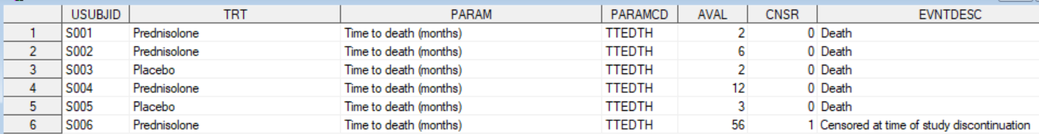
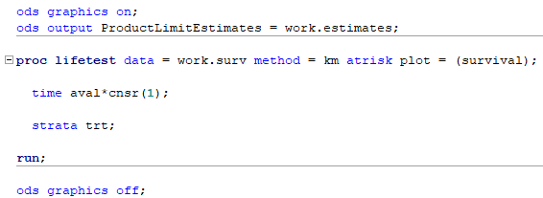
SAS Code – Proc Lifetest
Censor variable
0 = Observed event
1 = Censored
Input Dataset…
Use proc lifetest to calculate Kaplan Meier estimates of survival probabilities…
Treatment variable
Survival times
Notes:
Well first we want our input dataset in the correct format, usually contained in the ADTTE analysis dataset. We will have one record per subject, with corresponding variables for their treatment group and survival time, as well as an indicator variable to specify whether the subject was censored. In our example we use the variable, CNSR which takes the value 1 if the subject was censored, and 0 otherwise, however it’s always important to check which level of the variable indicates censoring, for example it’s also perfectly acceptable for 0 to indicate a subject was censored, and 1 to indicate the event was observed instead.
This data can then be fed into proc lifetest, which is the SAS procedure that can be used to generate Kaplan-Meier estimates of survival. Here we have specified our method as KM, standing for Kaplan-Meier however this is always the default so this isn’t technically necessary. The time statement here is the only one that is required, and this is where we specify the failure time variable, which for us is the variable AVAL. This is also where can we specify the censoring variable if this is necessary, which for us it is, and we therefore follow AVAL with an asterisk and the variable CNSR. The censoring variable should have brackets after, containing the value, or values of the variable that indicate censored subjects.
Strata is an optional statement, used to specify the variable containing the strata levels. Strata are formed according to the non-missing levels of the variable, however the missing option can be specified to allow missing levels as a valid stratum level. Here we use the treatment variable so that our Kaplan-Meier estimates are calculated by treatment group which is probably what we’re all used to seeing most commonly, however we might be interested in investigating the difference in survival between any number of distinct groups in our population, for example between sex or age groups.
Proc lifetest is a very useful procedure, because as well as calculating the Kaplan-Meier estimates for us, it also creates a number of useful outputs datasets and plots. To determine which plots are created we use the plot option on the lifetest statement, but it’s important here to include the ods graphics on and off options in your code to ensure these graphs are created. Here, I have specified to create just one plot, survival, which creates the Kaplan-Meier survival plot which we will look at in just a minute.
There are also a number of different ODS output datasets associated with proc lifetest, one of which we are most often interested in is the one specified here, ProductLimitEstimates, which creates an output datasets with our Kaplan-Meier estimates in. I have also specified the atrisk option here, which adds two additional variables to the ProductLimitEstimates dataset relating to the number of patients at risk at each timepoint.

Slide 13
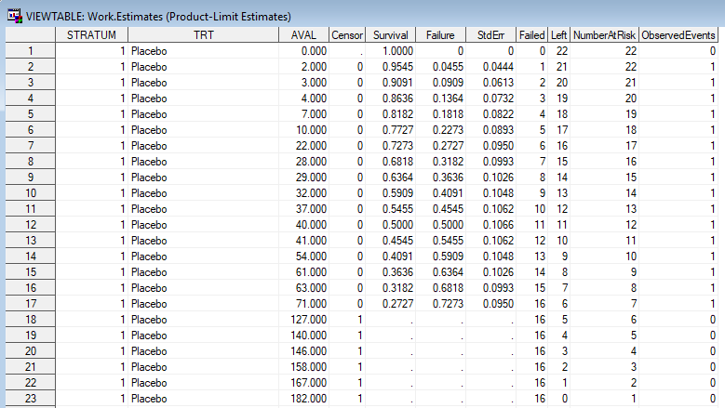






SAS Code - Output
$$t_{j}$$
$$c_{j}$$
$$\hat{S}(t_{j})$$
$$n_{j}−d_{j}$$
$$n_{j}$$
$$d_{j}$$
atrisk
Notes:
So this is what our ProductLimitEstimates dataset looks like, where our final two columns are the variables added by specifying the atrisk option. Overall, we can see a lot of similarities here with the table we created when calculating the estimates by hand. Instead of intervals we just have our survival time Tj which is contained in the variable AVAL, and we have Nj, Dj and Cj in our variables Number at risk, observed events and censor. And finally, we have our survival estimates, S(t) in the survival variable. What is missing in this table is Pj, the probability of surviving each interval, but that’s okay. We don’t necessarily use it for anything, it’s just an intermediate step in our overall calculation of the survival estimates.
Now that we have our estimates, it’s possible to present this in a slightly more aesthetically pleasing way, using a Kaplan-Meier plot, which I mentioned before is something that proc lifetest will do for you if you specify it in the plots option.

Slide 14
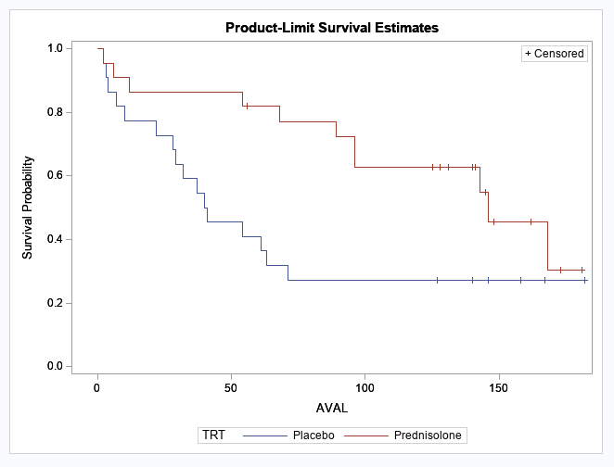
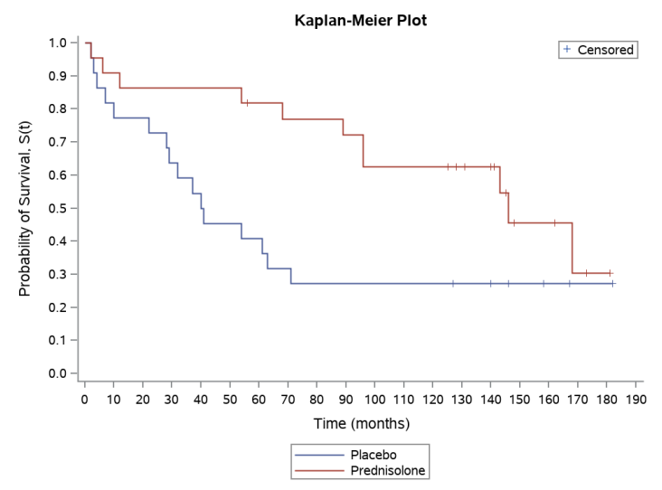
SAS Code – Kaplan Meier Plot
ODS output SurvivalPlot
Notes:
The plot on the left-hand side of the slide is what the Kaplan Meier plot looks like when automatically produced by proc lifetest. It is a step plot of the survival estimates, with each strata presented on the same plot, and censored observations indicated using tick marks. The survival probability estimates S(t) are plot versus time on the x axis. We can see the lines for both treatment groups start at 1, and then step down at each event time, to the probability of a subject surviving event free beyond that time point. So, for example, if you wanted to know the probability of a subject surviving, event-free, beyond 50 months, you would read along to 50 on the x axis, and find the corresponding survival probability for each treatment group on the y-axis. Here, this would be about 0.45 for the Placebo group versus about 0.85 in the Prednisolone treatment group.
This is a quick and useful visualisation of the data, however it’s often not exactly what is requested by the client in the shells. For example, they might want to use different colours or different axis labels. Although it is possible to make some cosmetic changes to the output that SAS creates, often it is necessary to create the plot manually using SGPLOT, and this is what I’ve done with the figure on the right. Something to note here, is that if you are creating your own plot, it is easier to do this using the data from ODS Survival plot instead of ProductLimitEstimates, as it is already in a useable format, and does not need any further modifications.

Slide 15
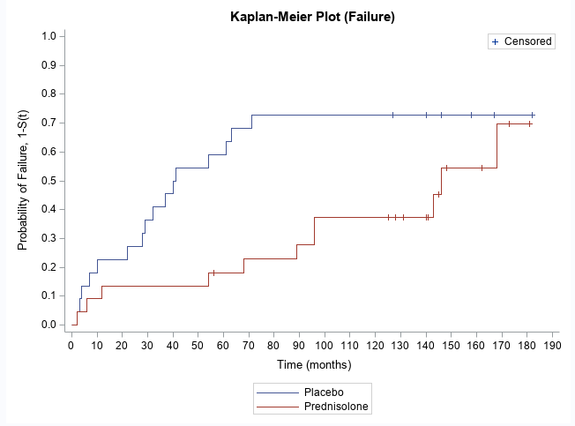

SAS Code – Probability of Failure
$$1−S(t)$$
Notes:
Another reason we may want to use SGPlot and create our Kaplan-Meier plot manually, instead of using the output from proc lifetest, is that occasionally, the event of interest is more easily interpreted if we consider the probability of failure, instead of the probability of survival. So if we consider the case that our example data was actually times until drug discontinuation say, then instead of being interested in the probability of survival beyond time t, that is, still being on the drug, we might instead be interested in the probability of failure before time t, which in this case would be discontinuing the drug. We still calculate our Kaplan-Meier estimates as usual but instead we are interested in the probability of failure, 1-S(t), instead of the probability of survival. Here we have the same output from the ProductLimitEstimates dataset from proc lifetest, where can see that the failure estimates are contained in the Failure variable. The plot is an example of what it would look like if we were to plot the Kaplan-Meier estimates in this scenario, where we see the estimates would start at 0 instead of 1 and then increase at each event time t. When reading the estimates from the plot, they would be interpreted as the probability of failing, that is discontinuing the drug, before time t. This serves as a good example of why it’s always important to consider the context of the analysis before attempting to interpret the results, and always check that the axis and footnotes accurately reflect the analysis being considered, so that any reader can easily interpret what is happening.

Slide 16
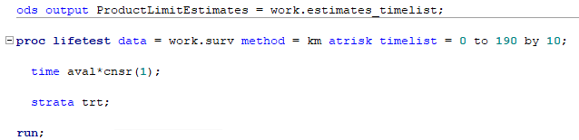
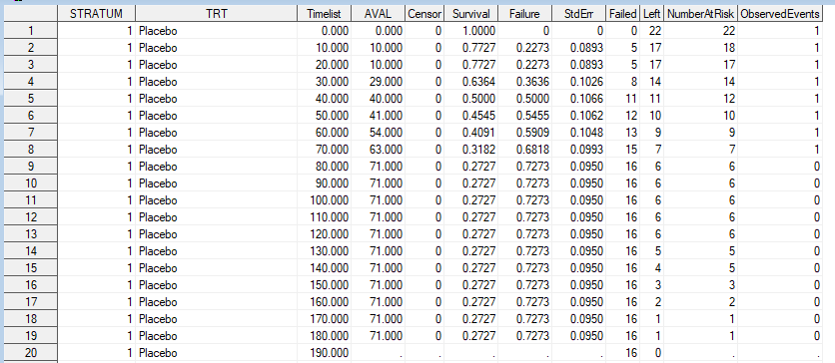
SAS Code – Patients at Risk
Notes:
Now, returning to the original data, and considering the probability of survival, another common client request when producing Kaplan Meier plots is to include a number at risk table at the bottom of the plot. Again, in this case it would be much easier to do this using SGPlot and add the table manually. A useful option to use in these cases is the timelist option, which allows you to specify the times at which you would like to know the number of patients at risk. For example, in our plot the x axis spans zero to 190 months, increasing by 10 months each time. We therefore might be interested in adding the number of patients at risk at each of these time points. To do this, we add the option timelist equals 0 to 190 by 10 on our proc lifetest statement, and our resulting dataset will look like this. We now have an additional variable, timelist, containing our times specified, as well as our number of patients at risk.

Slide 17
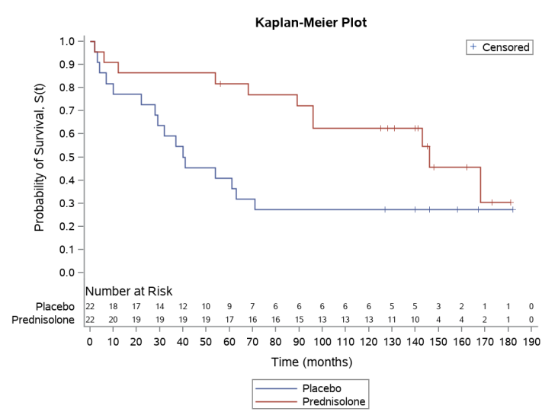
SAS Code – Patients at Risk
Notes:
Adding these to our plot would therefore look something like this, which we achieve by adding an xaxistable statement into Sgplot. We now have the same plot as before, but now includes the number of patients at risk for each treatment group, at each of our specified timepoints.
So we’ve got our estimates, and we’ve created a Kaplan-Meier plot, but what are we interested in now? Well what we may want to know is if there is a difference in survival between the strata, be that age, sex, or in our case, treatment group. So basically, does taking the drug, Prednisolone make a difference to your probability of survival? The Kaplan-Meier plot is a really helpful tool which can aid a visual inspection on which of the two arms has a better prognosis. The blue arm, representing the Placebo treatment group has a quicker decrease in it’s probability of survival, whereas the Prednisolone group decreases much slower, indicating perhaps that those on the Presnisolone treatment do have the better prognosis.
A way to quantify this would be to look at the average survival time across treatment groups. Recalling that survival data are usually positively skewed, we are often interested in the median survival time as a point estimate, instead of the mean.

Slide 18
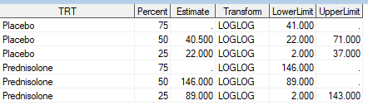
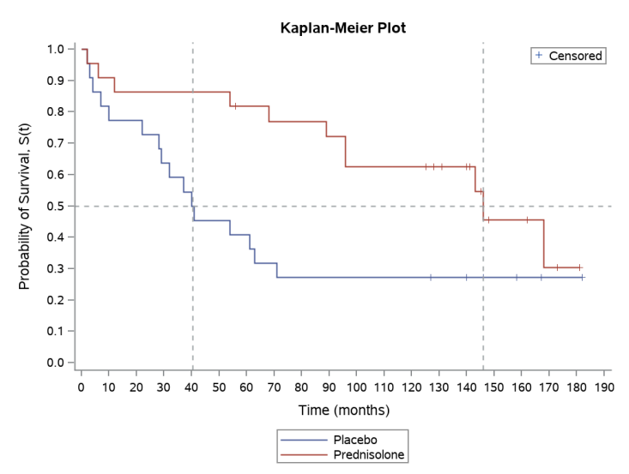
SAS Code – Median
Median survival time = Smallest time for which $\hat{S}\left(t\right)<0.5$
Notes:
We can find the median survival time as the smallest time for which S(t) is less than 0.5, and this is calculated by proc lifetest, and stored in the ODS Quartiles dataset. As well as including the median, the dataset also contains the 25 and 75 percent quartiles, which might also be of interest. We can take the estimates of the median for each treatment group and add them to the Kaplan Meier Plot as shown here. This gives further plausibility to our hypothesis that Prednisolone has the better prognosis of the two treatment groups, with a median survival time of 146 months, much higher than the Placebo group median of 40.5 months.
As helpful as all of this is, we may now be interested in performing a formal comparison of the survival between these treatment groups. This is possible through something called the log rank test, and while this is not something that I will be covering today, this is something that will be covered later in this series of introductory talks, as well as in the formal stats training that will be coming soon!

Slide 19
Summary
Time to event data can be censored and is often positively skewed.
The Survivor function, S(t), is the probability that an individual survives beyond a certain time t, event free.
The Kaplan-Meier method is used to estimate S(t) and is useful for a comparison of survival across groups of subject.
Use proc lifetest in SAS to obtain Kaplan-Meier estimates of survival, as well as other useful output including:
Kaplan Meier Plot
Number of Patients at Risk
Quartile Estimates (e.g. Median)
Notes:
So just to summarise what I’ve talked about today. We looked at what time to event data is and some of it’s features, including censoring. We looked at defining the survivor function, S(t) which is the probability that an individual survives beyond a certain time t, event free. We discussed how to estimate the survivor function using the Kaplan-Meier method. And finally we looked at using the proc lifetest procedure in SAS to calculate these estimates, as well as obtaining useful outputs such as the Kaplan-Meier plot, patients at risk, and quartile estimates.

Slide 20
4. RESOURCES

Slide 21
Resources
SAS Documentation: https://documentation.sas.com/?cdcId=pgmsascdc&cdcVersion=9.4_3.4&docsetId=statug&docsetTarget=statug_lifetest_syntax01.htm&locale=en#statug.lifetest.lftodsplots
Bland, J. Martin, and Douglas G. Altman. "Survival probabilities (the Kaplan-Meier method)." Bmj 317.7172 (1998): 1572-1580.
Altman, Douglas G., and J. Martin Bland. "Time to event (survival) data." Bmj 317.7156 (1998): 468-469.
Collett, David. Modelling survival data in medical research. CRC press, 2015.
Notes:
And just finally, I’ve got a handful of useful resources here, including the link to the SAS documentation for proc lifetest, which I would always recommend as the first place to look if you’re not sure of anything when running survival analysis using SAS.

Slide 22
Thank you! Any Questions?
Notes:
And that’s it! Thank you so much for listening, and does anyone have any questions?

